Slide 1
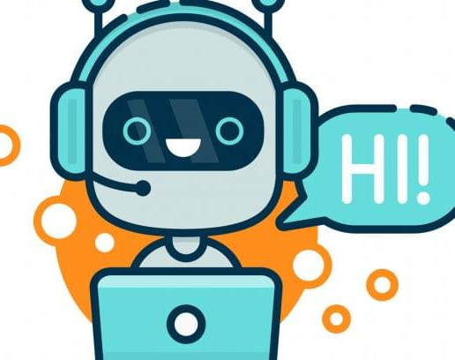
Self learning Chatbot
DOMAIN: Machine-learning
MADE BY-
ARPIT RASTOGI

Slide 2
Introduction
A chatbot is an Machine Learning(ML) that can simulate a conversation with user in natural language through messaging applications, websites, mobile apps or through the telephone
Nowadays chatbots are used to efficiently carry out digital communication.
Chatbots understand what a human wants, and guides them to their desired outcome with little work for the end user as possible.
Many of the conversations between a human and a chatbot are repetitive.
Like a virtual assistant for your customer experience touchpoints.
Example :Amazon’s Alexa, Google Now, Microsoft’s Cortana and Apple’s Siri are all virtual digital assistants you may have hear,

Slide 3
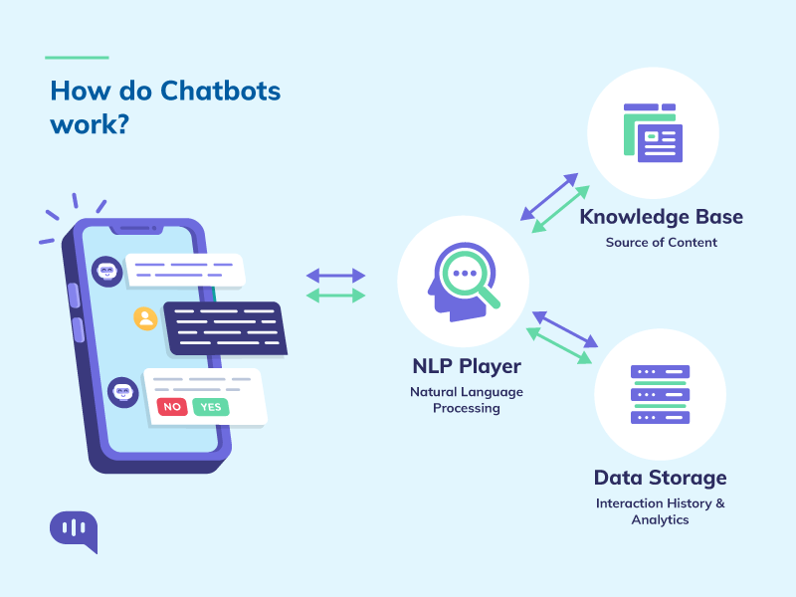

Slide 4
Problem Statement
Communicating with customers through live chat interfaces has become an increasingly popular means to provide real-time customer service in many e-commerce settings.
Today, human chat service agents are frequently replaced by conversational software agents or chatbots, which are systems designed to communicate with human users by means of natural language often based on Machine Learning
The primary means of communication with a chatbot is via text. And customers prefer this method.
Example : We are Creating a Chatbots which answer the customer query of all types

Slide 5
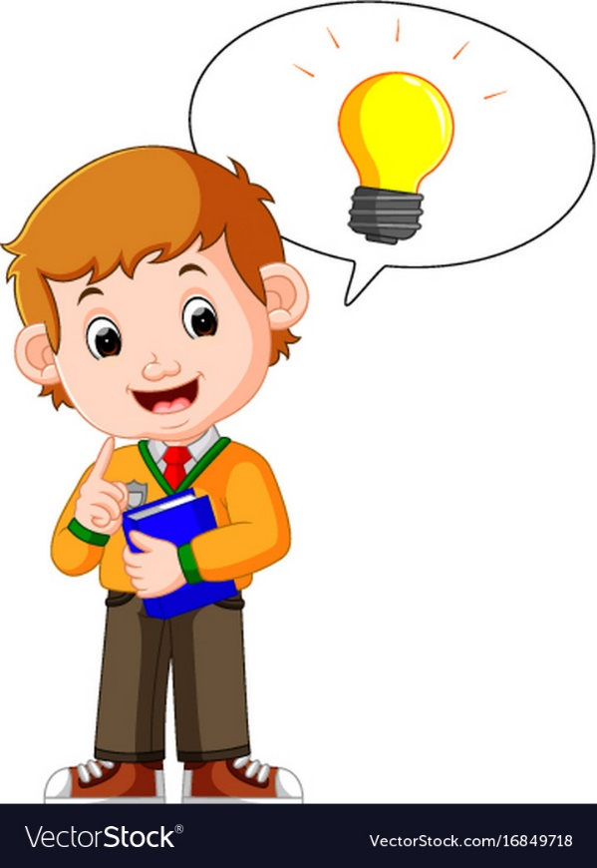
Literature Review

Slide 6
Title | Author name and Year | Methods | Merits | Demerits
Chatbot in Python | Akshay Kumar, Pankaj Kumar Meena, Ms. Sangeetha in 2019 | Using Python with Machine learning and GUI tkinter | No wait time Quick issue resolution | Chatbots require Constant Maintenance
An Intelligent Behaviour Shown by Chatbot System | Vibhor Sharma, Monika Goyal, Drishti Malik in 2017 | Using Phycharm , Machine learning using Python with libraries Tkinter , chatterbot etc | Gather Customer Insights. Improve Customer Satisfaction. | Chatbots lack the backing of the right algorithms that are powered by natural language processing, machine learning, and emotional intelligence.
College Enquiry Chatbot Using A.L.C.E | Balbir Singh Bani, Ajay Pratap Singh in 2017 | A.L.I.C.E (Artificial Linguistic Internet Computer Entity), GNU General Public License to develop our chatterbot system. | Alice stored a huge corpus text and Elizabeth provides the grammatical analysis for sentences. | Unlike humans, every chatbot needs to be programmed differently for a new business which increases the initial installation cost.

Slide 7
Chatbot development using Python | Shreyashkar Sharma in 2020 | The standard model Artificial Intelligence Markup Language(AIML) and Natural Language Processing. | Developers coordinate their with their client inquiries and reply with the best appropriate answer with the blend of machine learning tools and models. | Chatbots is that they do not understand human context.
A Smart Chatbot Architecture based NLP and Machine Learning for Health Care Assistance | Soufyane Ayanouz , Boudhir Anouar Abdelhakim, Mohammed Benhmed in 2020 | Artificial intelligence, conversational agents, modeling of conversations, natural language, neural machine translation | Chatbots built for structured conversations are highly scripted, which simplifies programming | Fixed Rule-based Grammatical Errors Predefined or Closed-domain Ambiguity
An intelligent web-based voice chat bot | Manoj lall, S.Sinha in 2009 | AI, XML, JAVA, AIML, ALICE | This framework is not limited to chat applications only it can also listen to user input and solve the issues. | Customers Could Become Frustrated. Because many chatbots work from a limited data base, they can't improvise.

Slide 8
Architecture diagram and
Module identification

Slide 9
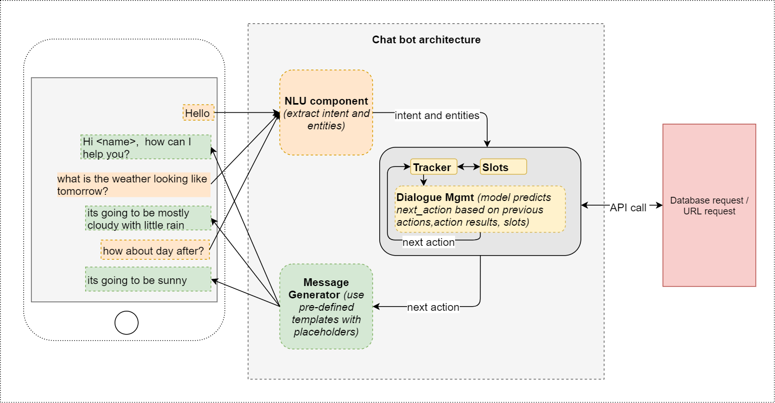
Architecture of Chatbot

Slide 10
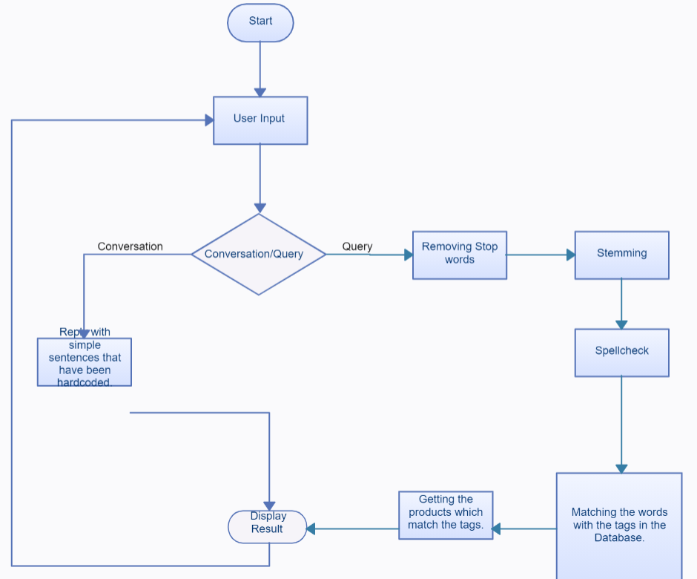
Project Flow Chart

Slide 11
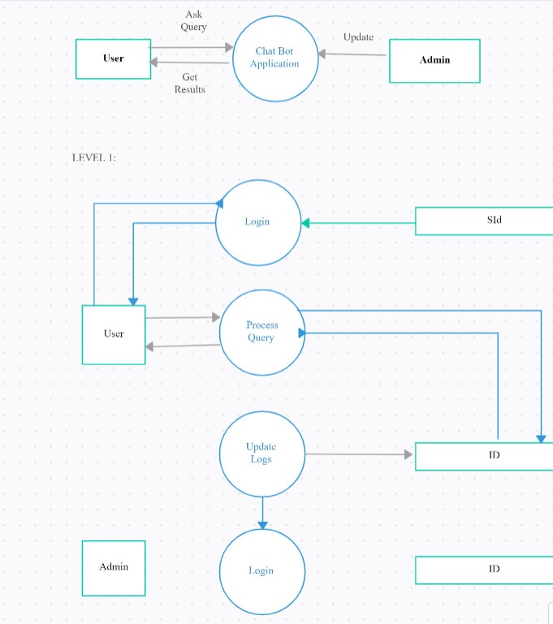
Data flow Diagram

Slide 12
General Architecture of System
Chatbots in of itself is hard to establish as a comprehensive conversational interface, adding voice adds significantly to this.
This comprehension include intent and entity recognition. Intents can be seen as verbs and entities as nouns.
Text based bots have in the very least a Natural Language Understanding (NLU) component.Where as a voice bot demands an initial speech recognition layer (speech to text) and a final speech generation layer (text to speech).
All intelligence is not vested within the NLU capabilities. Bots must have access to an external base of knowledge and common sense via API’s; such that it can provide the function of competence, answering user questions.

Slide 13
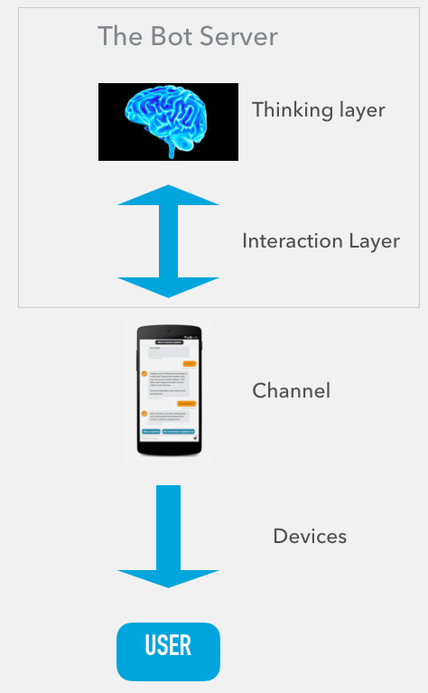
General Architecture Of System

Slide 14
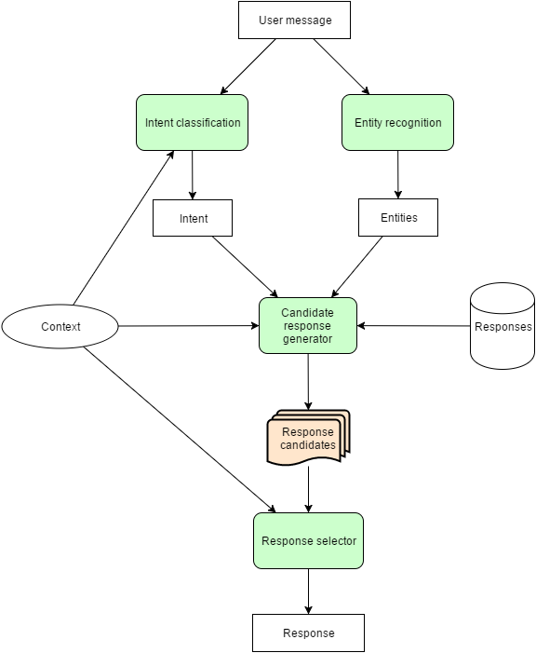
Main Modules

Slide 15
Main Modules
Interactions between main modules
Chatterbot Module : ChatterBot comes with a data utility module that can be used to train chat bots. At the moment there is training data for over a dozen languages in this module.
This module include training of My Bot to take all type of data from Database and self learning .
Tkinter Module : This is a simple GUI (Graphical User Interface) chat application where multiple users can connect with each other in a client-server architecture i.e the clients will interact with the help of the server.
To display my Chatterbot conversation in chat window and to solve Customer Quries

Slide 16
Conclusion
In this project we have seen the self learning Chatbot which can responds all query for any customer care service and give a appropriate answer to solve it in better manner.
After doing review on various libraries like Chatterbot , tkinter, pyttsx3 and speech recognition.
Today, human chat service agents are frequently replaced by conversational software agents or chatbots, which are systems designed to communicate with human users by means of natural language often based on Machine Learning
The primary means of communication with a chatbot is via text. And customers prefer this method.
Using all these libraries create something like Example :Amazon’s Alexa, Google Now, Microsoft’s Cortana and Apple’s Siri are all virtual digital assistants you may have hear,

Slide 17
References
Bayan Abu Shawar and Eric Atwell, 2007 “Chatbots: Are they Really Useful?”
LDV Forum - GLDV Journal for Computational Linguistics and Language Technology.
http://www.ldv-forum.org/2007_Heft1/Bayan_Abu-Shawar _and_Eric_Atwell.pdf
Bringing chatbots into education: Towards natural language negotiation of open learner models. Know.- Based Syst. 20, 2 (Mar. 2007), 177-185.
Intelligent Tutoring Systems: Prospects for Guided Practice and Efficient Learning. Whitepaper for the Army's Science of Learning Workshop, Hampton, VA. Aug 1-3, 2006.
http://en.wikipedia.org/wiki/Chatterbot
ALICE. 2002. A.L.I.C.E AI Foundation, http://www.alicebot.org/
A chatbot is an Machine Learning(ML) that can simulate a conversation with user in natural language through messaging applications, websites, mobile apps or through the telephone.

Slide 18
Thank You

